Slide 1
Dynamo:
Amazon’s Highly Available Key-Value Store
Team Members
Anshu G, Jhukirtha M, Sahil G,
Siddharth B, Vedant M

Slide 2
Introduction and
Background
Motivation
System Assumptions and Requirements
Service Level Agreements
Design Considerations

Slide 3
Motivation
Traditionally, production systems stored their data in Relational Databases
Most of Amazon’s services only stored and retrieved data by a primary key.
Did not require complex querying and management functionality offered by an RDBMS.
Excess functionality requires expensive hardware and highly skilled personnel
The available technologies for replication are limited, and they typically choose consistency over availability

Slide 4
System Assumptions and Requirements
Query Model :
Simple read and write operations to a data item that is uniquely identified by a key
ACID Properties :
ACID guarantees tend to have poor availability.
Dynamo targets applications that operate with weaker consistency if this results in high availability.

Slide 5
System Assumptions and Requirements
Efficiency :
Amazon’s services have stringent latency requirements
Dynamo is only used by Amazon’s internal services. It’s operation environment is assumed to be non-hostile and there are no security related requirements such as authentication and authorization.
Each service will use a distinct instance of Dynamo

Slide 6
Service Level Agreements (SLA)
Formally negotiated contract where several system related characteristics are agreed upon.
Includes the client’s expected request rate distribution for a particular API and the expected service latency
Common approach: Defining SLA in terms of average, median, and expected variance
Experiences with Amazon’s systems shows defining SLA in percentile gives a better overall experience
Notes:
Example : A service guaranteeing that it will provide a response within 300ms for 99.9% of its requests for a peak client load of 500 requests per second.

Slide 7
Design Considerations
Data replication algorithms used in commercial systems traditionally perform synchronous replica coordination in order to provide a strongly consistent data access interface.
When dealing with the possibility of network failures, strong consistency and high data availability cannot be achieved simultaneously.
Dynamo is designed to be an eventually consistent data store; that is, all updates reach all replicas eventually.

Slide 8
Design Considerations
An important design consideration is to decide when to perform the process of conflict resolution and who will perform the process.
Dynamo provides an “always writable” data store.
This is because for a number of Amazon’s services, rejecting customer updates would lead to a poor customer experience.

Slide 9
Design Considerations
Some other principles embraced in Dynamo’s designs are
Incremental Scalability : Dynamo should be able to scale out one node at a time, with minimal impact on both operators of the system and the system itself.
Symmetry : Every node in the system should have the same set of responsibilities. There should be no distinguished node with an extra set of responsibilities.

Slide 10
Design Considerations
Some other principles embraced in Dynamo’s designs are
Decentralization : This is an extension of symmetry. The design should favor decentralized peer-to-peer techniques over centralized control.
Heterogeneity : The system should be able to exploit the heterogeneity in the infrastructure it works on. The work distribution must be proportional to the capacity of the individual servers.

Slide 11
System Architecture
Partitioning
Replication
Data versioning
get() & put() operations
Handling failures
Membership and Failure detection
Storage plugins

Slide 12
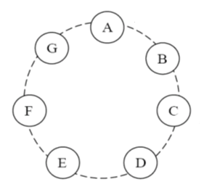
Partitioning
Consistent hashing
The output range of the hash is a fixed circular space (or “ring”)
Addition/removal of a node affects its immediate neighbors only
Disadvantages:
Non uniform load/data distribution due to random position assignment
Performance capability of each node not taken into account

Slide 13
Partitioning
Virtual nodes
Each node is assigned to multiple points in the ring
A virtual node looks like a single node but each physical node is responsible for more than one virtual node
Advantages:
Load distribution when a physical node fails
Load distribution when a physical node is added to a virtual node
Heterogeneity

Slide 14
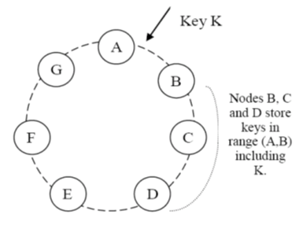
Replication
Data is replicated in N nodes, where N is configurable
Each key is assigned to a coordinator node
The coordinator node replicates the key at N-1 nodes (clockwise) in the ring
Notes:
Coordinator node: handles read/write operations
Preference list

Slide 15
get() & put() Operations
R & W are the minimum number of nodes participating in a successful read & write operation respectively
W=N & R=1: Read optimized, strong consistency
W=1 & R=N: Write optimized, strong consistency
W+R <= N: Weak consistency, read might not see the latest update
W+R > N: Strong consistency, read will see at least one copy of the latest update
The user can choose any values for R, W & N
Setting W + R < N helps maintain write latency while allowing some replication. This comes at the cost of consistency.
Notes:
Context: contains object metadata such as version

Slide 16
get() & put() Operations
Dynamo exposes 2 operations:
get(key): Returns a single object or a list of objects with a context
put(key, context, object): Writes the replicas to the disk
put() operation:
On receiving a put() request with the key, context (vector clock), and the object, the coordinator generates the corresponding new vector clock and writes it locally
It then sends the new version to the N highest-ranked reachable nodes
If at least W-1 nodes respond, the client is acknowledged that the write was successful
get() operation:
The coordinator requests all versions of the data from the N highest-ranked reachable nodes
Then it waits for R responses before returning the result
If there are conflicting versions, the application reconciles according to business logic
The application then sends the reconciled data through a new get() call
Notes:
Context: contains object metadata such as version

Slide 17
Data Versioning
The result of each modification is a new and immutable version of the data
Since Dynamo provides eventual consistency, an object may have multiple versions when a get() call is executed
Vector clocks used for reconciliation

Slide 18
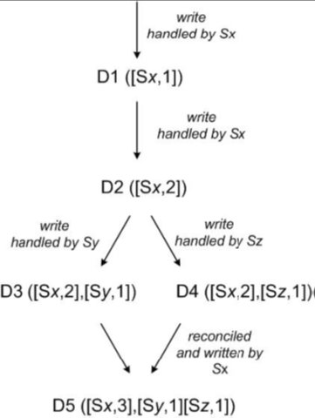
Vector Clocks
Vector clock is a list of (node,counter) pairs
Every modification on the data generates a new object with the associated vector clock
Reconciliation is done during reads depending on the vector clock

Slide 19
Handling Temporary Failures
Quorum is the minimum no of votes required to allow a transaction.
In Dynamo, node failures are handled using Sloppy Quorum approach
In Sloppy Quorum, all read and write operations are performed on the first N “healthy” nodes in the preference list.
To ensure that read and write operations are not failed during temporary node failures, Dynamo uses Hinted Handoff

Slide 20
Hinted Handoff
When A is temporarily down or unreachable during a write, a replica that would normally have lived on A will now be sent to D
Nodes that receive hinted replicas will keep them in a separate local database that is scanned periodically.
Once A has recovered, D will attempt to deliver the replica to A
Again: “always writeable”
Notes:
Advantages

Slide 21
Handling Permanent Failures
There are scenarios in which hinted replicas become unavailable before they can be returned to the original replica node.
To detect replica inconsistencies and data verification, Merkle Trees are used.
Notes:
Advantages

Slide 22
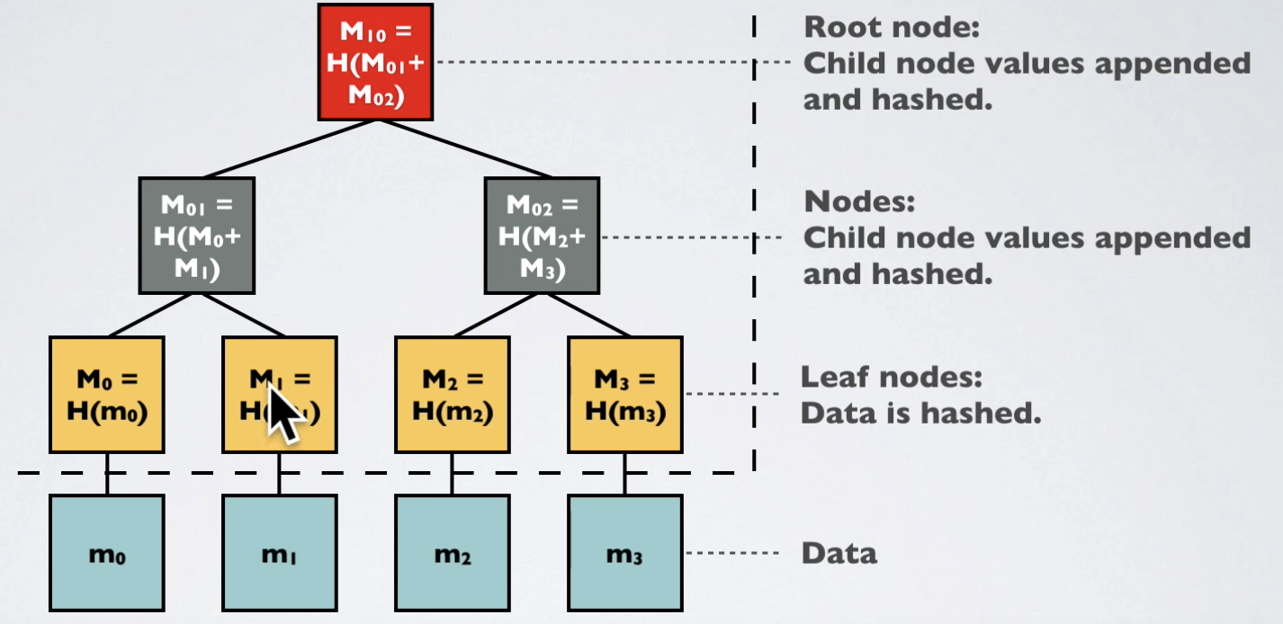
Merkle Trees
A Merkle tree is a hash tree where leaves are hashes of the values of individual keys. Parent nodes higher in the tree are hashes of their respective children.
The principal advantage of Merkle tree is that each branch of the tree can be checked independently without requiring nodes to download the entire tree or the entire data set.
Notes:
Advantages

Slide 23
Membership and Failure Detection
To prevent rebalancing of partition and unintentional startup of new nodes,an administrator has access to add a new node.
A gossip-based protocol propagates membership changes and maintains an eventually-consistent view of membership.
Failure detection is used to avoid attempts to communicate with unreachable peers
A purely local notion of failure is entirely sufficient. Eg: Node A considers node B failed if it does not respond to messages.
Decentralized failure detection protocols use gossip-style protocols that enable nodes to be aware of a node’s failure.
Notes:
Advantages

Slide 24
Storage Engines plug-in
A unique feature of Dynamo is that it gives the applications the choice to plug in different storage engines best suited for its access patterns.
Applications can choose between Berkeley Database (BDB), BDB Java edition, MySQL, and an in-memory buffer with persistent backing store.
Eg: BDB handles objects in order of tens of Kbs whereas MySQL can handle objects of larger sizes.
Notes:
Advantages

Slide 25
Performance
Performance and Experience
Balancing Performance and Durability
Partitioning of Placement of Keys
Load Balancing Efficiency
Divergent Versions
Client vs Server Driven Coordination
Balancing Background vs Foreground Tasks

Slide 26
Performance and Experience
Dynamo is used by several services with different configurations. Patterns in which Dynamo is used mainly:
-Business logic specific reconciliation - Eg: Merging different versions of a customer’s shopping cart.
-Timestamp based reconciliation- Eg: Customer Session Information
-High performance read engines-Eg: Services that maintain product catalog and promotional items. R=1, W=N.
Notes:
State values in R and W in read
Some of the Applications do not do application level reconciliations and some of them di at all he system does it for them, thus they let r+w>3. Common Configuration used by these applications is 3,2,2 thus all the tests are performed in this configuration.
Application level rec

Slide 27
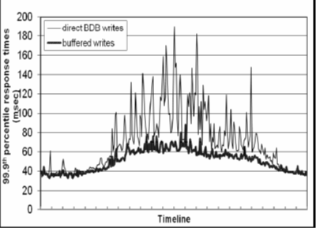


Balancing Performance and Durability
Write Operations
Storage Node
Object Buffer
Wr1 Wr2 Wr3 Wr4
Writer Thread
Lowering latency by a factor of 5 during peak traffic
Pros: Further improve performance
Cons: Trades durability for performance.
Solution: Durable Write
Read Operation search Buffer
Notes:
•System can be optimized without sacrificing the 99.9th percentile
•Buffer usage can decrease latency by a factor of 5 during peak traffic times •System can be optimized without sacrificing the 99.9th percentile

Slide 28
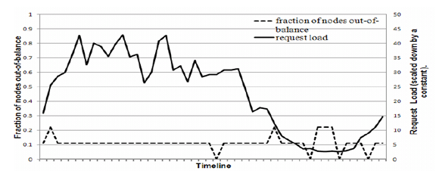
Ensuring Uniform Load Balance Distribution
-If Node’s request load > average load by less than a certain threshold (here 15%)
-Imbalance ratio = Fraction of nodes that are out-of-balance
Decreases with increasing load. Why?
Observe: During low loads the imbalance ratio is as high as 20% and during high loads it is close to 10%. Why?
Notes:
A uniform key distribution can help us achieve uniform load distribution
load imbalance and its correlation with request load, the total number of requests received by each node was measured for a period of 24 hours - broken down into intervals of 30 minutes.

Slide 29
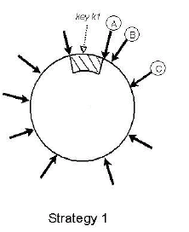
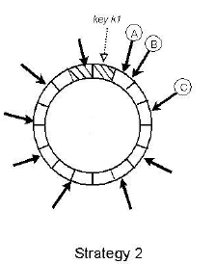
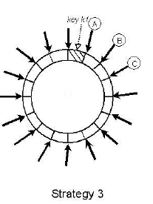
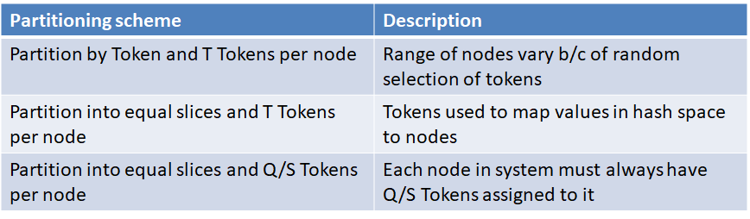
Partitioning and Placement of Keys
Evolution of Partitioning strategies on Load Distribution.
Note: Q is number of partition/ranges, S is the number of nodes
Notes:
Recalculate merkel trees, Data Retrieval takes longer time due to variable Data range.

Slide 30
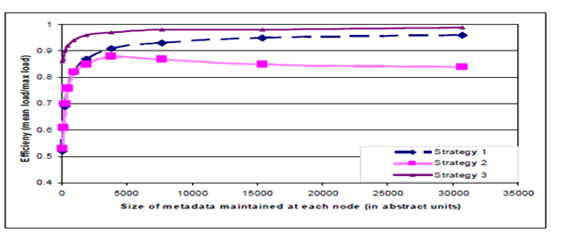
Load Balancing Efficiency
Strategy 3 is used. Why? Strategy 2 was interim setup
Strategy 3 | Strategy 1
Faster Bootstrapping | <24 hours Bootstrapping
Data Retrieval Fast | Slow Data Retrieval
Easy to archive | Difficult to Archive whole data
Notes:
evaluate the skew in their load distribution . Since dfficult to compare Periodical archiving of the dataset is a mandatory requirement for most of Amazon storage service

Slide 31
Divergent Version
Assumed Reason:
Node failures, data center failures, network partitions and Large number of concurrent writes to an item
Divergent versions are created rarely.
Occurrence: Number of Versions returned to the shopping cart
99.94 % requests of one version
0.00057 % requests of two versions
0.00047 % requests of three versions
0.00009 % requests of four versions
Evaluation: Divergent versioning due to increase in concurrent writes. Why?
Notes:
Key point is rare. Not affecting a lot of customers, It can tolerate a fairly consistent. the number of versions returned to the shopping cart service was profiled for a period of 24 hours.

Slide 32
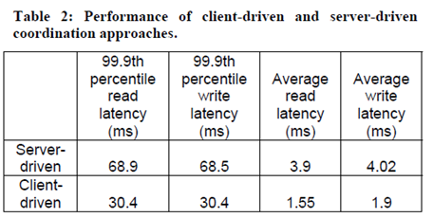
Client vs Server Driven coordination
Server:
Load Balancer is required
Any node can be coordinator for reads
Write requests coordinated by a node in key’s preference list.
Client :
Library can be used to perform coordination locally
Client downloads current view of node and can determine preference list for a key.
Notes:
Advantages

Slide 33
Balancing Background vs Foreground Tasks
Background tasks are integrated with a admission control mechanism.
Background tasks reserve run time slices using this mechanism.
Controller monitors latency in a given time window and checks if latencies are close to a desired threshold.
These comparisons are used to assess the resource availability for background tasks.
Notes:
When nodes are added/removed replica syncs happen, then data is handed-off to new nodes. These are happening in the background.
Along with normal get/ put operations are occuring.

Slide 34
Conclusion
Dynamo introduces some important features, let’s review them:
One virtual node mapping to multiple physical nodes, to maintain load balance in nodes.
Consistent Hashing Ring : to determine which key value pair goes to which nodes.
Vector clocks to maintain versions of the data, which are used to resolve conflicts.
Merkle trees are used to recover from permanent failure and get the latest version of the data.
Adjustable Storage Engine plug-in : Applications can choose which Storage Engine to use according to their access patterns.

